Slide 1
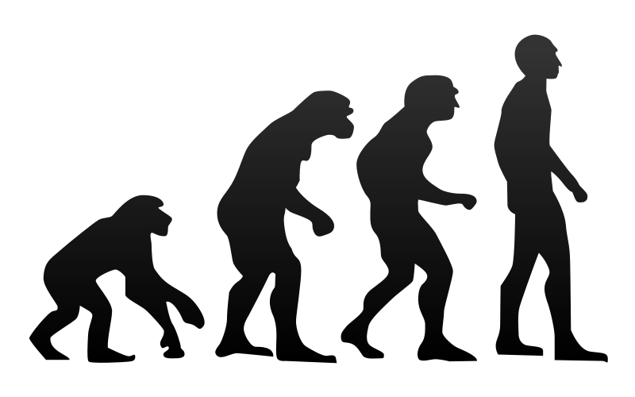
Evolution of the Entity Framework
K. Scott Allen
@OdeToCode

Slide 2
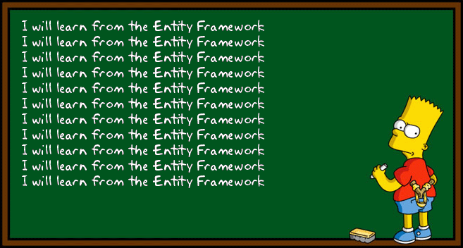

Slide 3
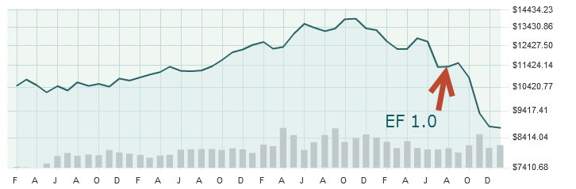

Slide 4

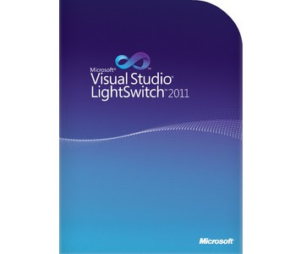


Slide 5
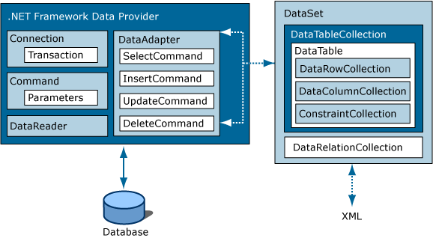

Slide 6
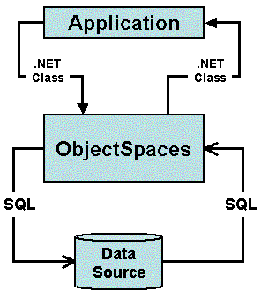

Slide 7


Slide 8
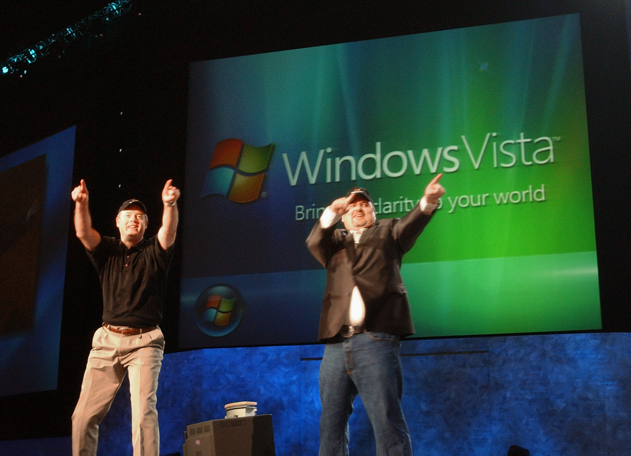

Slide 9
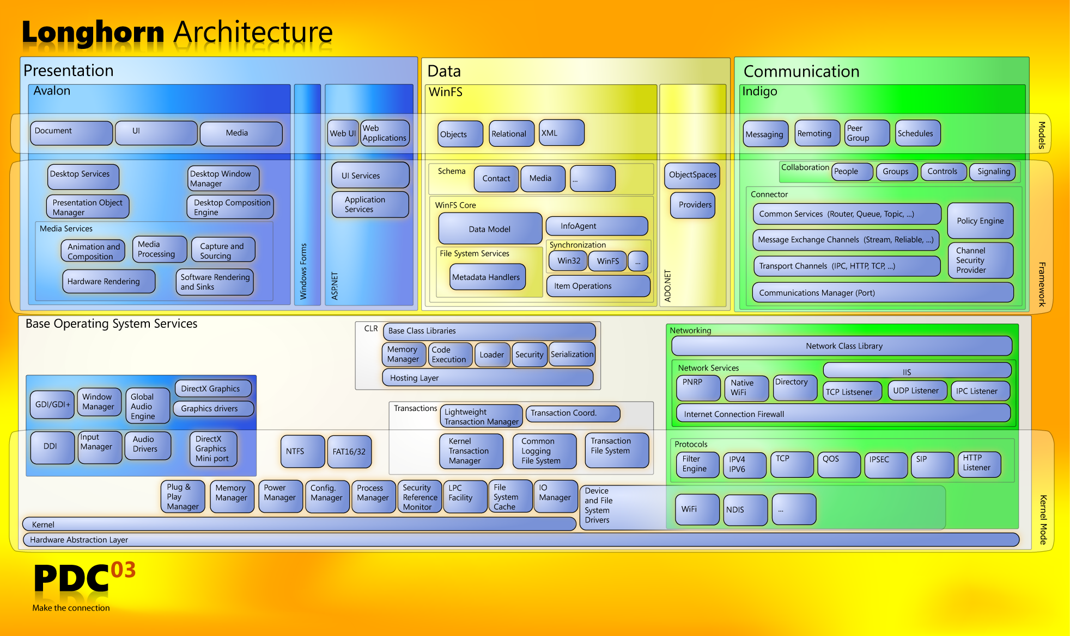


Slide 10
Why WinFS?
In the technology industry, there is a growing "perfect storm"—a combination of trends and technologies that will allow the next quantum leap in the way you develop and work with your information.
http://msdn.microsoft.com/en-us/library/aa480687.aspx

Slide 11
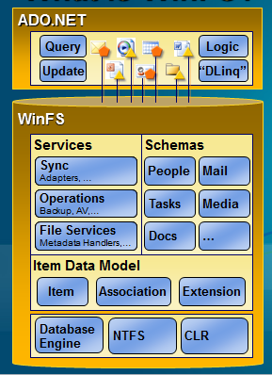

Slide 12
“The Origin of LINQ to SQL”
We on the outside used to refer to WinFS as the black hole, forever growing, sucking up all available resources, letting nothing escape and in the end producing nothing except possibly a gateway to an alternate reality.
http://blogs.msdn.com/b/mattwar/archive/2007/05/31/the-origin-of-linq-to-sql.aspx

Slide 13


Slide 14
Lesson 1 Don’t Let The Astronauts Solve The Customer’s Problem

Slide 15
Where is WinFS now?
The WinFS APIs were a precursor to a more generalized set of object/relational APIs, which is now shipping as what we call entity framework in ADO.NET.
http://channel9.msdn.com/Blogs/JonUdell/Where-is-WinFS-now

Slide 16
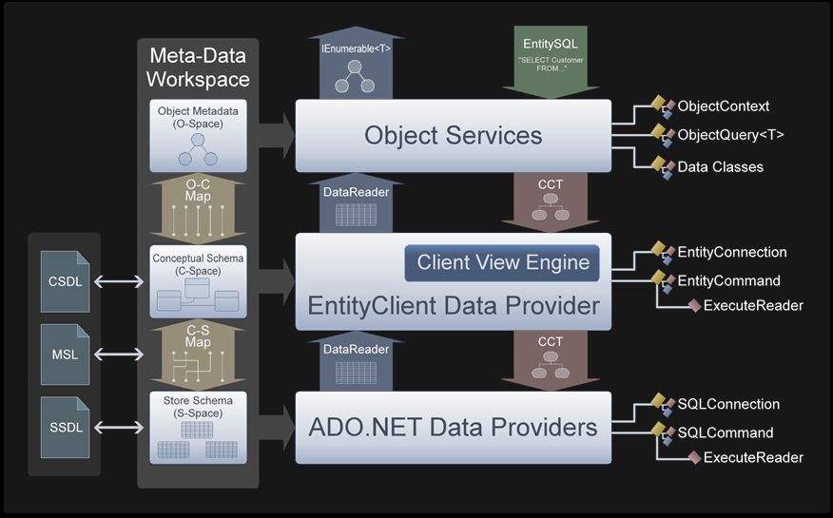

Slide 19
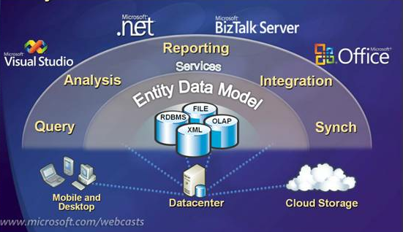

Slide 21
Unimplemented LINQ operators
No capability for model-first design
No support for complex types
No support for enum types or unsigned integers
No implicit loading of relationships
Limited stored procedure support
Unnecessarily complexity in generated SQL code
Unnecessary complexity in generated C# code
Performance

Slide 22
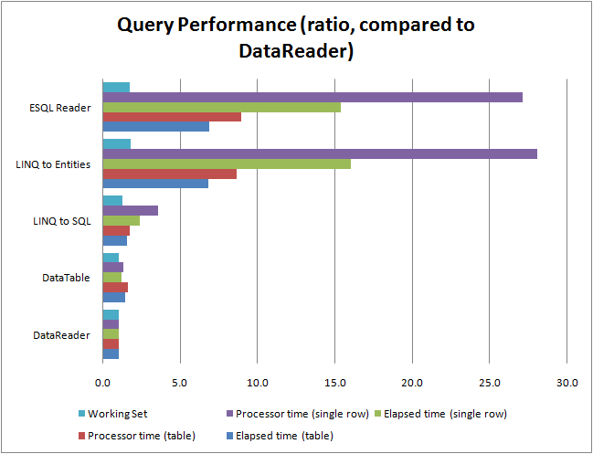
http://toomanylayers.blogspot.com/2009/01/entity-framework-and-linq-to-sql.html

Slide 23

Why is Dropbox more popular than other programs with similar functionality?

Slide 24
Well, let's take a step back and think about the sync problem and what the ideal solution for it would do:
There would be a folder.
You'd put your stuff in it.
It would sync.
They built that.
http://www.quora.com/Dropbox/Why-is-Dropbox-more-popular-than-other-programs-with-similar-functionality

Slide 25
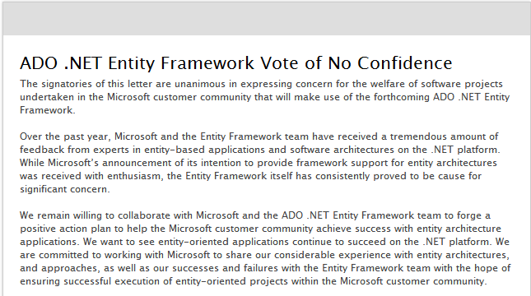

Slide 26
Lesson 2 Solve One Customer Problem Well

Slide 27
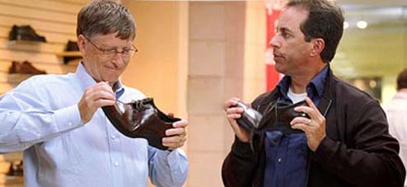

Slide 28
EF is not an ORM
Often, people categorize Entity Framework as an Object/Relational Mapper and try to compare it to other O/R Mappers. I dare say that’s an apples-to-oranges kind of comparison.
…
Entity Framework is much bigger than a mere O/R Mapper. It is a conceptual-level development platform, and its ORM capabilities are an interface for applications to interact with conceptual models.
http://blogs.msdn.com/b/esql/archive/2007/12/14/entityframework_5f00_orm.aspx

Slide 29
Why Use EF?
The big difference between the EF and nHibernate is around the Entity Data Model (EDM) and the long-term vision for the data platform we are building around it.
http://blogs.msdn.com/b/dsimmons/archive/2008/05/17/why-use-the-entity-framework.aspx

Slide 30


Slide 31



Slide 32


Slide 33


Slide 34

LINQ to SQL
Silverlight
SQL Notification Services
Oslo / M
CardSpace
Hailstorm
Windows CE
Code Access Security
Office Web Components

Slide 35
Lesson 3 Don’t Ask The Customer For A Long Term Loan

Slide 36
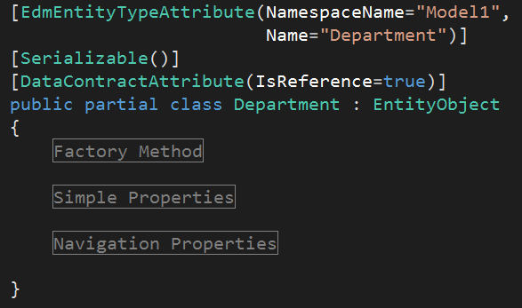

Slide 37
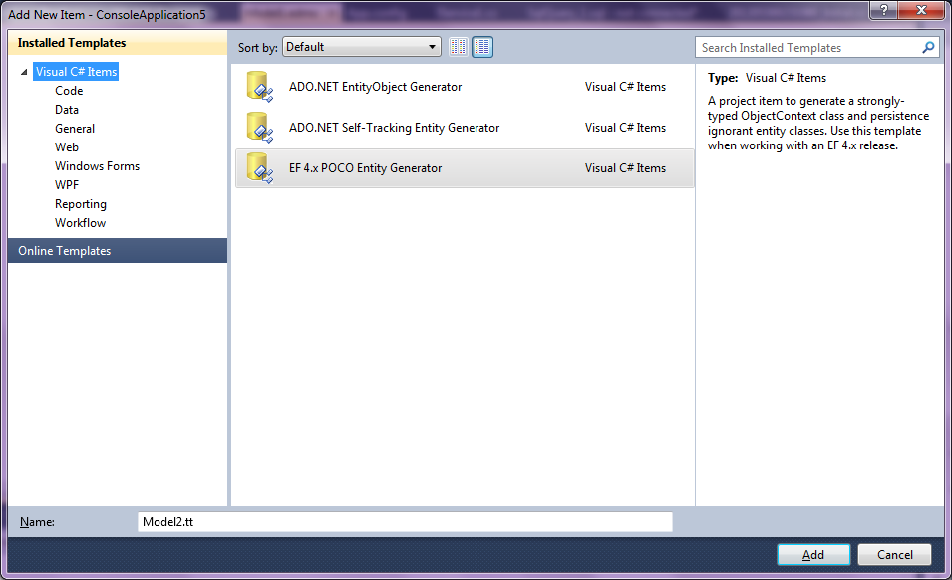

Slide 38

There is less cognitive load because rather than being forced to think about everything—business logic, persistence, transactions etc.—at once you can instead focus on one thing at a time.
You can first design and implement the business logic and then, once that is working, you can deal with persistence and transactions.

Slide 39
The Entity Framework encourages the Anemic Domain Model anti-pattern by discouraging the inclusion of business logic in the entity classes. While it is possible for the business logic to be written in partial classes, this adds some awkwardness to the code as the entity data and the entity business rules and logic live in separate knowledge and user experience contexts.

Slide 40


Slide 41


Slide 42
Lesson 4 Understand the Customer’s Problem

Slide 43
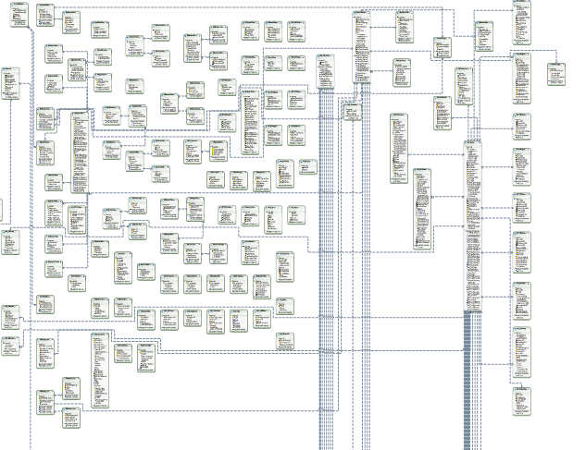

Slide 44
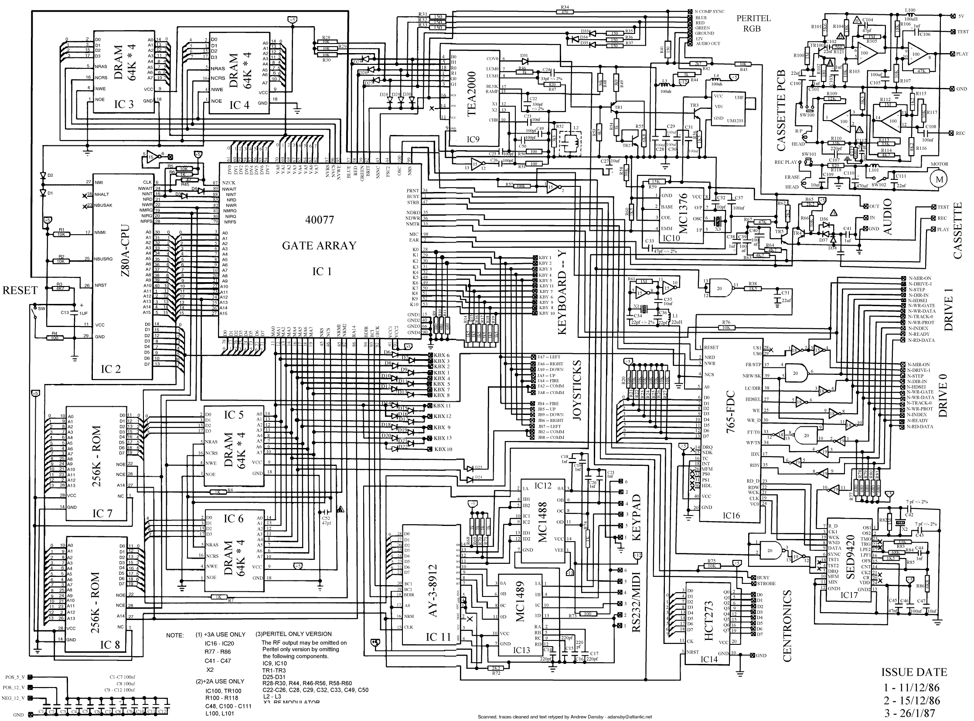

Slide 46
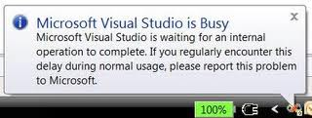

Slide 47
Problem in Mapping Fragments starting at lines 6, 69: Non-Primary-Key column(s) CalendarID are being mapped in both fragments to different conceptual side properties - data inconsistency is possible because the corresponding conceptual side properties can be independently modified.

Slide 48
Problem i Kartlegging Fragments starter på 6 linjer, 69: Ikke-Primær-Key kolonnen (e) CalendarID blir kartlagt i begge fragmenter til ulike konseptuelle side egenskaper - data inkonsekvens er mulig fordi de tilsvarende konseptuelle sidene egenskaper kan være uavhengig endres.

Slide 49
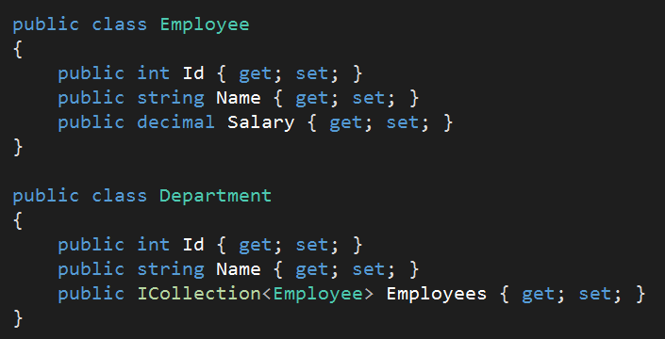
<?xml version="1.0" encoding="utf-8"?>
<edmx:Edmx Version="3.0" xmlns:edmx="http://schemas.microsoft.com/ado/2009/11/edmx">
<!-- EF Runtime content -->
<edmx:Runtime>
<!-- SSDL content -->
<edmx:StorageModels>
<Schema Namespace="Model1.Store" Alias="Self" Provider="System.Data.SqlClient" ProviderManifestToken="2008" xmlns:store="http://schemas.microsoft.com/ado/2007/12/edm/EntityStoreSchemaGenerator" xmlns="http://schemas.microsoft.com/ado/2009/11/edm/ssdl">
<EntityContainer Name="Model1StoreContainer">
<EntitySet Name="Employees" EntityType="Model1.Store.Employees" store:Type="Tables" Schema="dbo" />
<EntitySet Name="Departments" EntityType="Model1.Store.Departments" store:Type="Tables" Schema="dbo" />
<AssociationSet Name="EmployeeDepartment" Association="Model1.Store.EmployeeDepartment">
<End Role="Employee" EntitySet="Employees" />
<End Role="Department" EntitySet="Departments" />
</AssociationSet>
</EntityContainer>
<EntityType Name="Employees">
<Key>
<PropertyRef Name="Id" />
</Key>
<Property Name="Id" Type="int" StoreGeneratedPattern="Identity" Nullable="false" />
<Property Name="Name" Type="nvarchar(max)" Nullable="false" />
<Property Name="Salary" Type="nvarchar(max)" Nullable="false" />
<Property Name="HireDate" Type="nvarchar(max)" Nullable="false" />
<Property Name="EmployeeDepartment_Employee_Id" Type="int" Nullable="false" />
</EntityType>
<EntityType Name="Departments">
<Key>
<PropertyRef Name="Id" />
</Key>
<Property Name="Id" Type="int" StoreGeneratedPattern="Identity" Nullable="false" />
<Property Name="Name" Type="nvarchar(max)" Nullable="false" />
</EntityType>
<Association Name="EmployeeDepartment">
<End Role="Employee" Type="Model1.Store.Employees" Multiplicity="*" />
<End Role="Department" Type="Model1.Store.Departments" Multiplicity="1" />
<ReferentialConstraint>
<Principal Role="Department">
<PropertyRef Name="Id" />
</Principal>
<Dependent Role="Employee">
<PropertyRef Name="EmployeeDepartment_Employee_Id" />
</Dependent>
</ReferentialConstraint>
</Association>
</Schema></edmx:StorageModels>
<!-- CSDL content -->
<edmx:ConceptualModels>
<Schema xmlns="http://schemas.microsoft.com/ado/2009/11/edm" xmlns:cg="http://schemas.microsoft.com/ado/2006/04/codegeneration" xmlns:store="http://schemas.microsoft.com/ado/2007/12/edm/EntityStoreSchemaGenerator" Namespace="Model1" Alias="Self" xmlns:annotation="http://schemas.microsoft.com/ado/2009/02/edm/annotation" annotation:UseStrongSpatialTypes="false">
<EntityContainer Name="Model1Container" annotation:LazyLoadingEnabled="true">
<EntitySet Name="Employees" EntityType="Model1.Employee" />
<EntitySet Name="Departments" EntityType="Model1.Department" />
<AssociationSet Name="EmployeeDepartment" Association="Model1.EmployeeDepartment">
<End Role="Employee" EntitySet="Employees" />
<End Role="Department" EntitySet="Departments" />
</AssociationSet>
</EntityContainer>
<EntityType Name="Employee">
<Key>
<PropertyRef Name="Id" />
</Key>
<Property Type="Int32" Name="Id" Nullable="false" annotation:StoreGeneratedPattern="Identity" />
<Property Type="String" Name="Name" Nullable="false" />
<Property Type="String" Name="Salary" Nullable="false" />
<Property Type="String" Name="HireDate" Nullable="false" />
</EntityType>
<EntityType Name="Department">
<Key>
<PropertyRef Name="Id" />
</Key>
<Property Type="Int32" Name="Id" Nullable="false" annotation:StoreGeneratedPattern="Identity" />
<Property Type="String" Name="Name" Nullable="false" />
<NavigationProperty Name="Employees" Relationship="Model1.EmployeeDepartment" FromRole="Department" ToRole="Employee" />
</EntityType>
<Association Name="EmployeeDepartment">
<End Type="Model1.Employee" Role="Employee" Multiplicity="*" />
<End Type="Model1.Department" Role="Department" Multiplicity="1" />
</Association>
</Schema>
</edmx:ConceptualModels>
<!-- C-S mapping content -->
<edmx:Mappings>
<Mapping Space="C-S" xmlns="http://schemas.microsoft.com/ado/2009/11/mapping/cs">
<EntityContainerMapping StorageEntityContainer="Model1StoreContainer" CdmEntityContainer="Model1Container">
<EntitySetMapping Name="Employees">
<EntityTypeMapping TypeName="IsTypeOf(Model1.Employee)">
<MappingFragment StoreEntitySet="Employees">
<ScalarProperty Name="Id" ColumnName="Id" />
<ScalarProperty Name="Name" ColumnName="Name" />
<ScalarProperty Name="Salary" ColumnName="Salary" />
<ScalarProperty Name="HireDate" ColumnName="HireDate" />
</MappingFragment>
</EntityTypeMapping>
</EntitySetMapping>
<EntitySetMapping Name="Departments">
<EntityTypeMapping TypeName="IsTypeOf(Model1.Department)">
<MappingFragment StoreEntitySet="Departments">
<ScalarProperty Name="Id" ColumnName="Id" />
<ScalarProperty Name="Name" ColumnName="Name" />
</MappingFragment>
</EntityTypeMapping>
</EntitySetMapping>
<AssociationSetMapping Name="EmployeeDepartment" TypeName="Model1.EmployeeDepartment" StoreEntitySet="Employees">
<EndProperty Name="Department">
<ScalarProperty Name="Id" ColumnName="EmployeeDepartment_Employee_Id" />
</EndProperty>
<EndProperty Name="Employee">
<ScalarProperty Name="Id" ColumnName="Id" />
</EndProperty>
</AssociationSetMapping>
</EntityContainerMapping>
</Mapping></edmx:Mappings>
</edmx:Runtime>
<!-- EF Designer content (DO NOT EDIT MANUALLY BELOW HERE) -->
<edmx:Designer xmlns="http://schemas.microsoft.com/ado/2009/11/edmx">
<edmx:Connection>
<DesignerInfoPropertySet>
<DesignerProperty Name="MetadataArtifactProcessing" Value="EmbedInOutputAssembly" />
</DesignerInfoPropertySet>
</edmx:Connection>
<edmx:Options>
<DesignerInfoPropertySet>
<DesignerProperty Name="ValidateOnBuild" Value="true" />
<DesignerProperty Name="EnablePluralization" Value="True" />
</DesignerInfoPropertySet>
</edmx:Options>
<!-- Diagram content (shape and connector positions) -->
<edmx:Diagrams>
</edmx:Diagrams>
</edmx:Designer>
</edmx:Edmx>

Slide 50
#nav a:hover { background-color: #AD310B;
transition: background-color 1000ms linear; }
<Canvas.Triggers>
<EventTrigger RoutedEvent="Canvas.Loaded">
<BeginStoryboard>
<Storyboard x:Name="ColorStoryboard">
<ColorAnimation
BeginTime="00:00:00"
Storyboard.TargetName="Page"
Storyboard.TargetProperty=
"(Panel.Background).(SolidColorBrush.Color)
From="Red"
To="Green"
Duration="0:0:4" />
</Storyboard>
</BeginStoryboard>
</EventTrigger>
</Canvas.Triggers>

Slide 51
Lesson 5 Have Empathy For The Customer

Slide 52
Summary
Don’t let astronauts solve the customer’s problem
Solve one customer problem well
Don’t ask the customer for a long term loan
Understand the customer’s problem
Have empathy for the customer
Questions?
scott@OdeToCode.com

